Slide 1

Introduction to Linux Day 2/10
Prepared by:
Gaurav Pokhrel
Rohan Raj Poudel
Jan, 2024
Gaurav P. | Rohan Raj P.

Slide 2
Agenda
Installation of Linux - Ubuntu
Familiarization with GNOME
Terminal and Shell
Basic commands – Part 1
ManPages in Linux
Jan, 2024
Gaurav P. | Rohan Raj P.

Slide 3
2.1 Installation
Disable Secure Boot
Enable Virtualization
Install Oracle VM VirtualBox
Install Ubuntu in your Virtual environment
Jan, 2024
Gaurav P. | Rohan Raj P.

Slide 4
SubTopic – Kernel Space vs User Space
Privileged vs Less-Privileged mode: Unrestricted Access vs Restricted Access
System Critical Operations vs User Applications
Direct Access To Hardware vs Interaction with Kernal using SystemCall
Jan, 2024
Gaurav P. | Rohan Raj P.

Slide 5
2.2 GNU and Open Source Licensing
GNU (GNU’s not UNIX): Project (1983) that aimed to create UNIX like OS
Promotes the idea of Open source project / free software.
GNU’s license: General-Public-License(GPL), widely used open source license
GNU lacked kernel (initially)
Linux developed in 1991, combined with GNU to create complete OS –GNU/Linux system
GNOME (defaults for most Linux distros) made for desktop environment on 1997
Jan, 2024
Gaurav P. | Rohan Raj P.

Slide 6
2.2 GUI
Linux GUI refers to the graphical user interface provided by the desktop environment running on top of the Linux kernel.
Various desktop environments are available for Linux including GNOME, KDE, Cinnamon, etc.
GUI typically includes a graphical shell, window manager, file manager, system settings, and other graphical elements to provide a user-friendly interface.
GUI allows users to interact with the operating system, launch applications, manage files, customize settings, and perform other tasks using a mouse or touchpad.
Jan, 2024
Gaurav P. | Rohan Raj P.

Slide 7
2.2 GNOME
Popular Desktop Environment
Clean, Simple and Easy to use
Extensions and theming options available
Provides a complete desktop experience
System-Menu, App-Launcher, Notification-Area
Jan, 2024
Gaurav P. | Rohan Raj P.

Slide 8
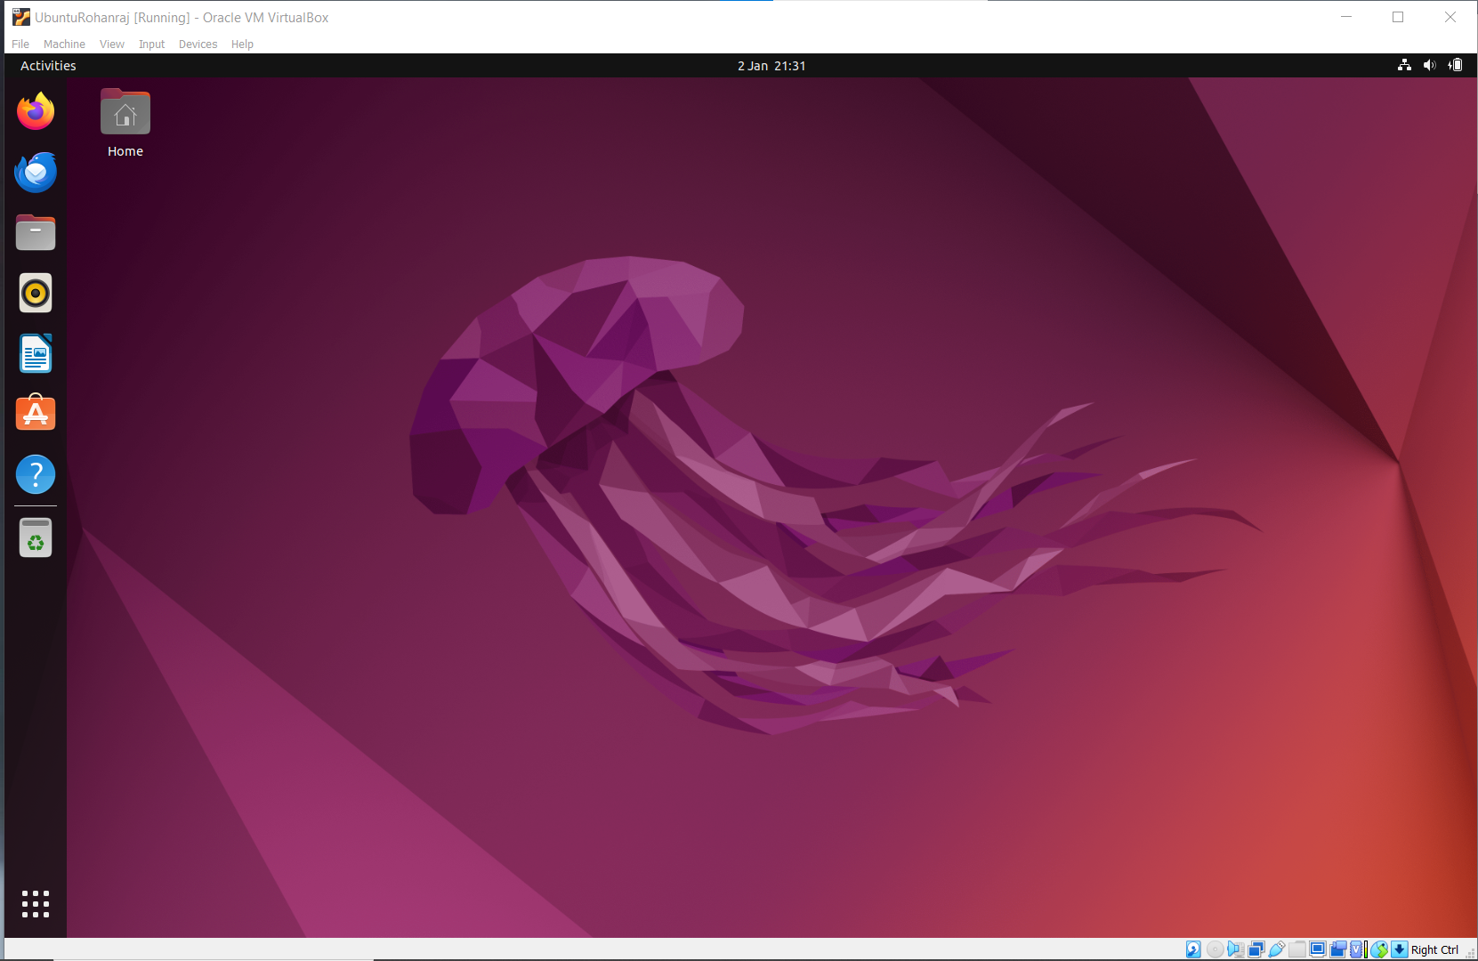
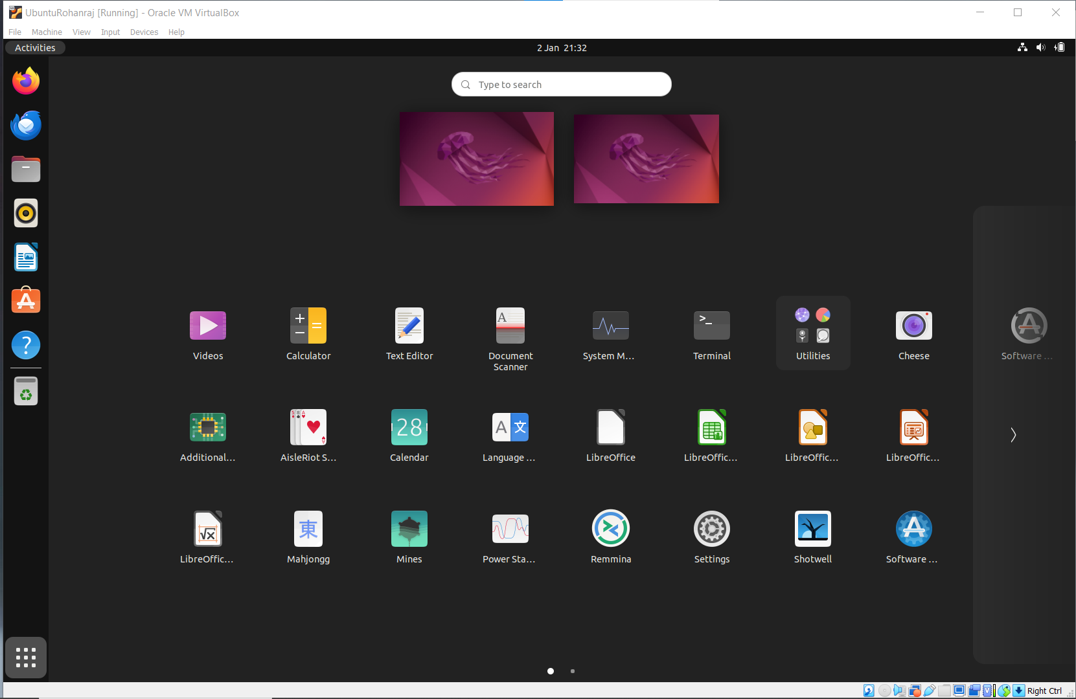
2.2 GNOME
Jan, 2024
Gaurav P. | Rohan Raj P.

Slide 9
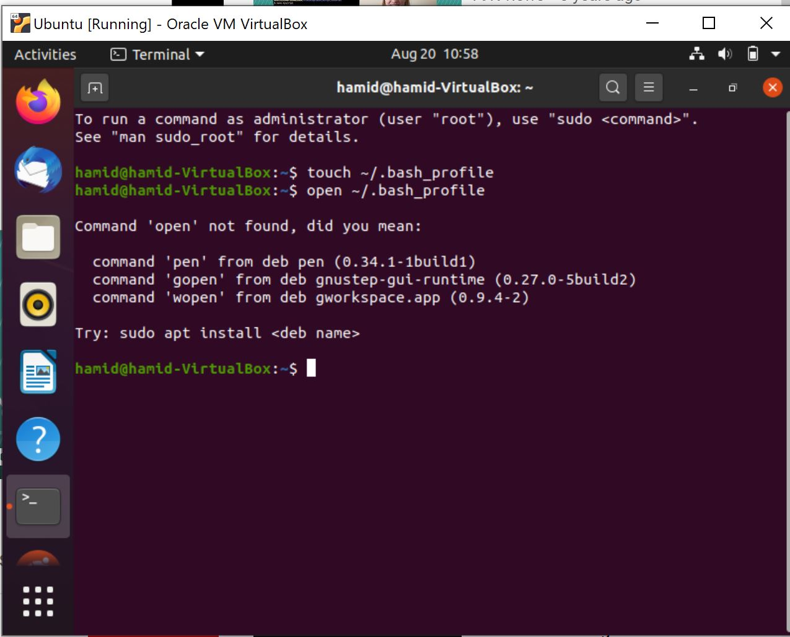
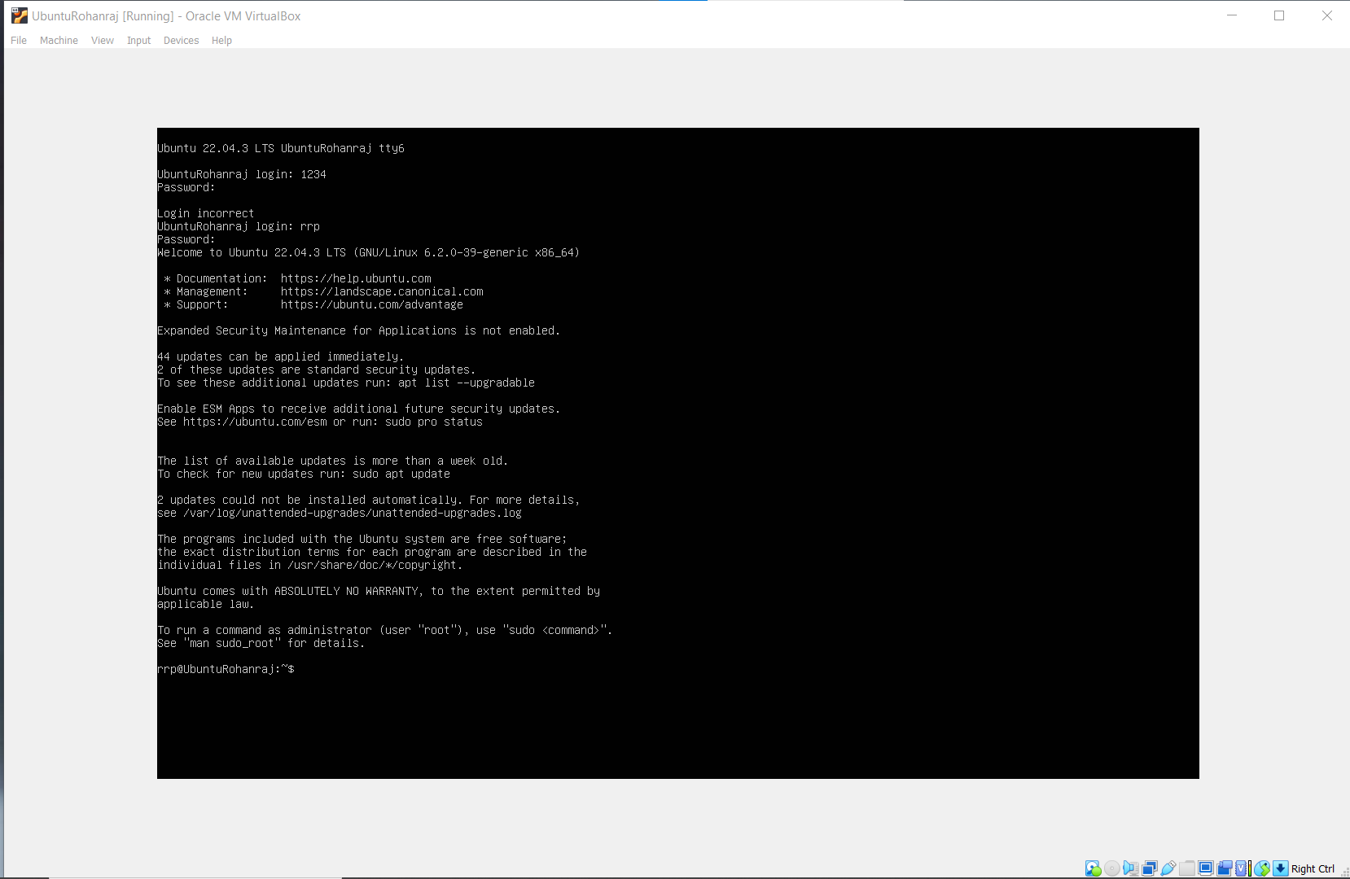
2.3 Terminal and Shell
Jan, 2024
Gaurav P. | Rohan Raj P.

Slide 10
Basic Linux Commands
ls
cd
pwd
mkdir
rmdir
cp
rm
touch
mv
Jan, 2024
Gaurav P. | Rohan Raj P.

Slide 11
Basic Linux Commands
ls
Command: ls
Purpose: Lists files and directories in the current directory.
Eg: ls , ls -l, ls -a, ls - - almost-all, ls -l *.pdf
cd
Command: cd
Purpose: Changes the current working directory.
Eg: (cd ..), (cd./Pictures/ ), (cd../Pictures/ )
Jan, 2024
Gaurav P. | Rohan Raj P.

Slide 12
Basic Linux Commands
3. pwd
Command: pwd
Purpose: Displays the current working directory.
Eg: pwd
4. mkdir
Command: mkdir
Purpose: Creates a new directory.
Eg: mkdir folder_name
Jan, 2024
Gaurav P. | Rohan Raj P.

Slide 13
Basic Linux Commands
5. rmdir
Command: rmdir
Purpose: Removes an empty directory.
Example: rmdir Empty_folder_name
6. cp
Command: cp
Purpose: Copies files or directories.
Example: cp file.txt /home/destination
Jan, 2024
Gaurav P. | Rohan Raj P.

Slide 14
Basic Linux Commands
7. rm
Command: rm
Purpose: Removes files or directories
Example: rm file_name , rm * , rm -r dir_name
8. touch
Command: touch
Purpose: Create file/ files.
Example: touch file or touch file1 file2….
Jan, 2024
Gaurav P. | Rohan Raj P.

Slide 15
Basic Linux Commands
9 mv
Command: mv
Purpose: move or rename files
Example: mv oldname newname , mv source destination
Jan, 2024
Gaurav P. | Rohan Raj P.

Slide 16
File Permissions
Permission Characters:
Each set of three characters consists of r (read), w (write), and x (execute) permissions.
If the permission is granted, the corresponding character is present; if not, a” -” is used.
File Type and Permissions:
The first character indicates the file type. Common types include - for a regular file, d for a directory, and l for a symbolic link.
The next nine characters represent the file permissions. They are divided into three sets of three:
The first set represents the owner's (user's) permissions.
The second set represents the group's permissions.
The third set represents others' (everyone else's) permissions.
Jan, 2024
Gaurav P. | Rohan Raj P.

Slide 17
File Permissions
Concept of Owner , group and world:
Owner:
The owner of a file or directory is the user who created or owns it.
The owner has the most control over the file, with the ability to read, write, and execute it.
The owner can also change the file's permissions, change its owner, and modify its group.
Jan, 2024
Gaurav P. | Rohan Raj P.

Slide 18
File Permissions
Concept of Owner , group and world:
Group:
A file or directory can be assigned a group, and members of that group are granted certain permissions based on the group settings.
Every user in Linux belongs to one or more groups.
Create group : sudo groupadd group_name
Add user to group: sudo usermod -aG group_name username
Check which groups a user belongs to : groups username
Jan, 2024
Gaurav P. | Rohan Raj P.

Slide 19
File Permissions
Concept of Owner , group and world:
World(others):
In Linux, the term "world" is often used in the context of file permissions to refer to everyone else who is not the owner of a file or a member of the group associated with that file.
The "world" permissions are the permissions that apply to all users who are not the owner or part of the group.
Jan, 2024
Gaurav P. | Rohan Raj P.

Slide 20
2.5 ManPages in Linux (Manuals)
Manual pages provide documentation and information about various commands, utilities, system calls, libraries, and other aspects of the operating system and software.
man [command_name] eg. man ls
Key navigation commands within the "man" pager include: Arrow Keys or "j" and "k": Scroll up and down. "q": Quit the manpager and return to the command prompt. "/": Search for a specific term. Enter the term and press "Enter" to search forward. Press "n" to go to the next occurrence.
Use the "apropos" command to search for manpages related to a specific keyword. eg. apropos copy
Jan, 2024
Gaurav P. | Rohan Raj P.

Slide 21
Conclusion
Mastering these commands is fundamental for Linux navigation and file manipulation.
Understanding the file and directory structure is crucial for effective system administration.
Practice using these commands to build confidence and efficiency.
Jan, 2024
Gaurav P. | Rohan Raj P.

